Slide 1
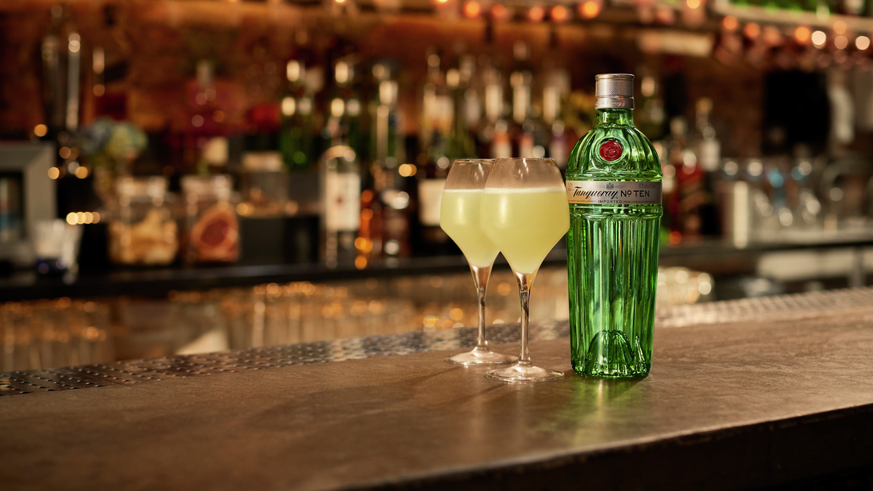
Agent Based Modelling
With Mu Sigma: August SteerCo Update
August 6, 2019
Prepared by Karen Chisholm, Nancy Hayes and Mu-Sigma team

Slide 2
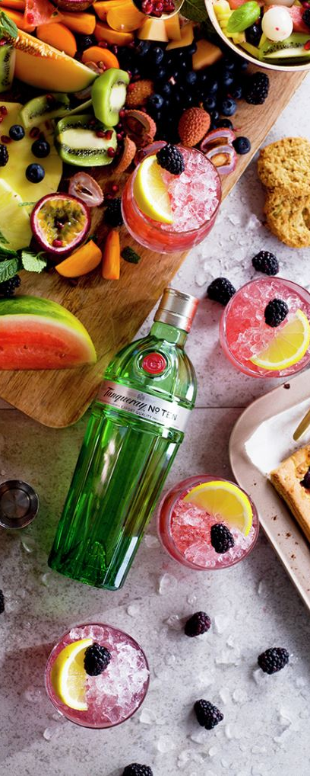
AGENDA
Background
Project Update
Timeline
Decisions
Overall Status with Risks/ issues
Deep Dive on Progress
Next Steps

Slide 3

Why try?
Diageo has identified Agent-Based Modelling (ABM) as a promising approach to the challenge of understanding the underlying drivers of major shifts in the drinks market.
A working model could help Diageo to understand the circumstances under which major shifts in category preference, such as the recent rise in the popularity of gin in Europe, can occur, and the actions we might be able to take in order to benefit.
By building a model of the drinks market to answer what-if questions, Diageo will be investing in an ongoing strategic capability that can be used to answer further questions about market dynamics, and that can be extended to cover other countries.
Create a game-changing, competitive advantage for Diageo

Slide 4

Scope: Australia + Category shifts
The model projects the sales impact of consumer behavior and cultural change. It’s total category not just brands, as such leveraged for brand and portfolio planning. We could generate category insights for our customers no other competitor would have. We could seek to understand:
What if population growth continues at ~2% PA driven by cap cities with a 50/50 mix of organic to immigration?
What if 15% of evening occasions cease to exist with a further 15% shifting to early afternoon?
What if online alcohol sales grow at 5% PA?
What if Bundys penetration grown rate trails behind competitors Jim/Jack/CC by 30%?
What if the Diageo portfolio increased its talkability/buzz of its brands 2x over as many years.
What if Bundy salience trajectory continues to decline at 1% PA?
Additionally this should connect the dots between penetration and volume considering all the macro inputs that drive this relationship ethnicity mix / per capita etc.
Page 4

Slide 5
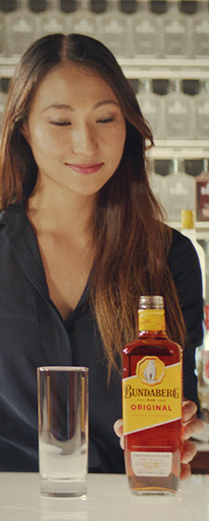
How we measure success
Complete the Project with Quality
Able to design and build a working ABM model
Scale
Diageo is excited by the capability and willing to invest more in building this strategic capability
Partnership
Diageo and Mu Sigma are able to partner and work together with ease
ABM of high quality generating at least one new insight
Mu Sigma brings significant value to enabling this transformation
We have a plan at the end of this project
Able to answer the Australia questions with some level of measured confidence

Slide 6
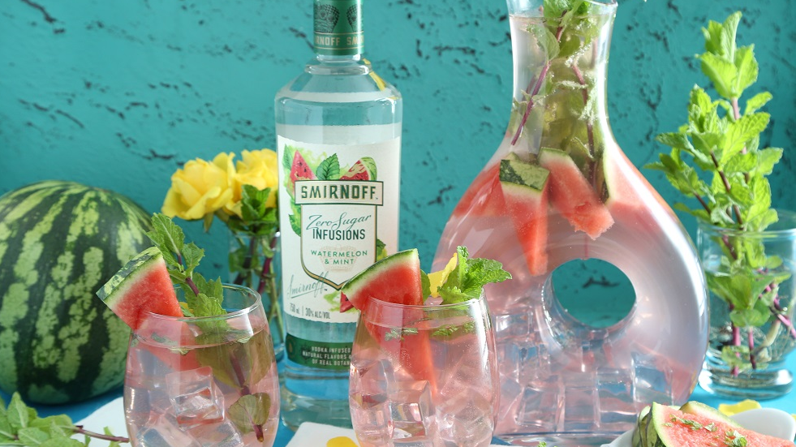
Project Update
March 12, 2019
Prepared by Karen Chisholm and Adam Ben-Yousef

Slide 7
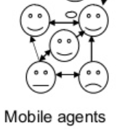

High Level plan
Today
Completion
Months
1
2
3
4
5
6
7
Governance Defined
Start-up
NDA Signed
5
9
SOW Signed
Diageo Access
New SOW for Scale to Production
Proof of Concept
Proof of Concept (3 months)
Proof of Concept and assessment of existing infrastructure
Consumer-level agent causal model
kickoff
Data Discovery
Design Workshops
Working session- Model walkthrough
Scale to Production
Approval
Create UI and Scale to Production (to be discussed)
Page 7

Slide 8
Decision on Solution plan
We recommended proceeding with delivery in R notebooks to deliver the pilot scope within original budget/timeline.
 | R Shiny | Power BI | R Notebooks
Feasibility | Not supported on AzureDB | Supported on AzureDB | Supported on AzureDB
Timelines | 3 weeks to develop (by end of August – within engagement scope) | 7 weeks to develop (additional 4 weeks beyond August – post engagement scope) | 2 weeks to develop (by end of August – within engagement scope)
Ease of Execution | Can be executed relatively easily to develop push-pull system for simulation | Requires additional trials and testing for simulation - working with PowerApps and creating a DB pipeline | Easy to execute and design – although it removes interactive dashboard capability
Cost Impact | £0 | £45,000 | £0
Deliverable Impact | Not Possible | Would deliver planned scope with increase in timeline and budget | Simulation Tool Not Available
Risk | Not Possible | High Risk | Low Risk
Overall | Not Possible | Consider for Phase 2 | Recommended Approach

Slide 9
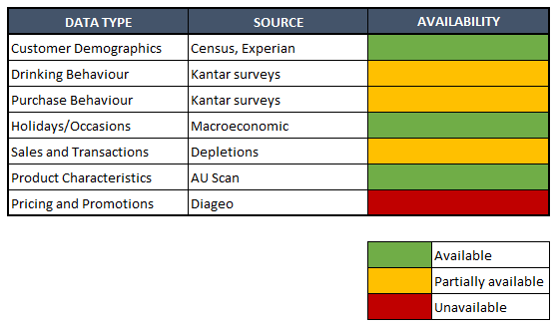
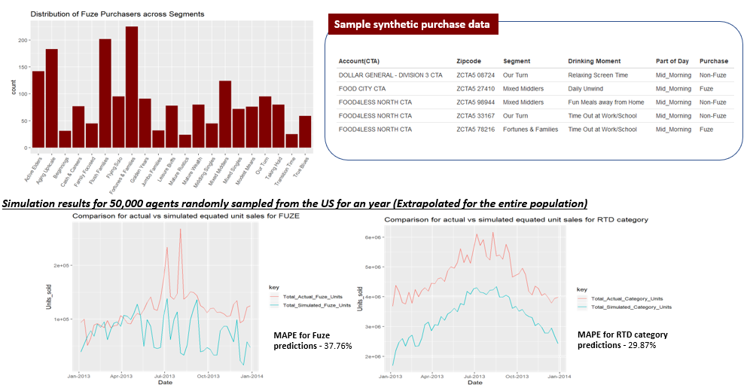
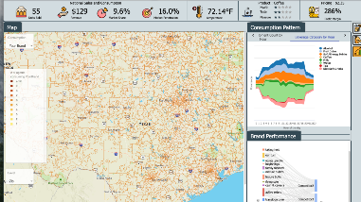
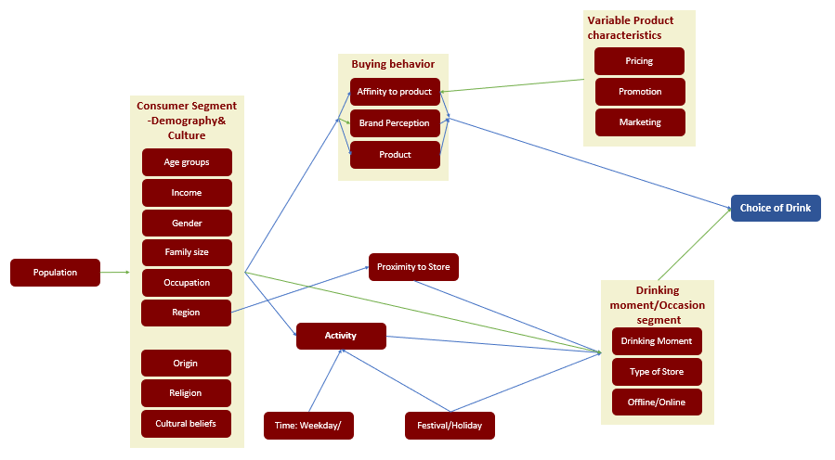
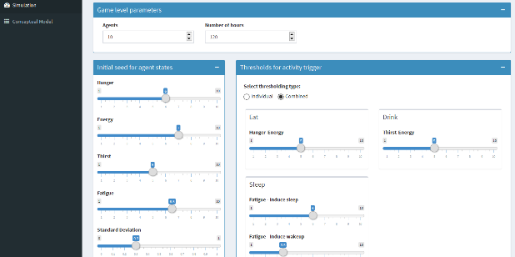
PROJECT progress
Today
Completed
In Progress
Phase 2
1. Data Consolidation
2. Network Design
3. Understand Consumer Behaviour
4. Simulation Tool
5. Productize
Phase 2
On Hold due to Solution Decision

Slide 10

ABM Australia Pilot – Status
Week Summary
June 25
Kickoff
July 26 July 31
Infrastructure and data acquisition
July 23 Aug 2
Data exploration and EDA
July 29 Aug 2
Initiate Model Results
Aug 26 Aug 31
Final model results
Issues/ Risks
No progress made
Some progress made
Sufficient progress made
Official kick off for the project
Obtained required infrastructure
Final data received from Kantar, except FY17 (low priority)
Data exploration in progress for sources identified
Initial model results will not include Kantar
Model with Kantar details will be completed by Aug 20th
Completed This Week | Planned Next Week | Issues/Risks/Help required | Decisions Made
Data Gathering & Exploration Accessing Kantar survey data to understand usability using updated files Exploration of ATL/BTL files to understand usage of promotions in model Created variables for temperature and holiday Model creation Model for activity using demographics, part of day and weekday/weekend Remove segment level and build on base segment due to unavailability of definitions Initial deliverables Data mapping file created with updated information and variables Initial notebook shared with workflow, EDAs and model design | Data exploration & fusion Complete Kantar data EDAs to ensure all files are usable and accessible Pricing model using Scan data Model creation Validate activity model Validate temperature, holiday and seasonality effects Incorporate pricing and promotions model design Working session Close data gaps to ensure every node is answerable Validate solution design and EDAs Ensure AA team is aligned with model construction details | [RISK] Kantar data to be validated Mu Sigma team to browse and validate Kantar files for mapping, weighing factor and questions answered [ISSUE] Diageo team wants more collaboration, more transparency and more communication from the Mu Sigma team to address potential risks of misunderstanding data or business context Additional data workshops and model reviews planned May need more workshops to ensure quality deliverable | R Markdown files will be provided as final outputs instead of Power BI Segment information is not being used in model as definitions are not available

Slide 11


Deep Dive – Model + Data
March 12, 2019
Prepared by Karen Chisholm and Adam Ben-Yousef

Slide 12
Data STATUS SUMMARY
Data | Received | Source | Available information | Coverage | Gaps | Usability/Implementation status | ETA
Consumer Demography | Yes | Experian | Region level summary of Age, Income, Mosaic segments etc.. | Recently captured | Need to approximate consumer level information using distributions across demographics, activity not available | Not Used - Approximation leading to inaccuracy | -
 | - | ABS(Official website of Australia) | Consumer demographics distribution -Age, Income, Gender, Qualification, Marital Status, Labour force status, Remoteness, Birth Country, State | Captured every 5 years Using 2015 Census | - | Used -to obtain population distribution across demographics | Done
Activity Survey | - | ABS(Official website of Australia) | Activity distribution for consumer demographics: Age, Income, Gender, Qualification, Labour force status, Remoteness, Birth Country | Captured in 2006 | - | Used -to train Activity model | Done
Temperature | - | BOM(Bureau of Metrology) | Minimum and Maximum Temperature across days for different cities | Jan 2016 - Jan 2019 | - | Used -to account for seasonality in sales | Done
Holiday | - | Australian government website | Holidays in a year at day level | Every year | - | Used -to account for seasonality in sales | Done
Consumer surveys | Yes | Kantar | Consumer demographics and preferences -Brand perception, Penetration, Drinking Moment(Occasion), Drink Choice for Age, Income, .. | F18 & F19 | Key variables like Ethnicity and other demographics are not available | Implementation in progress -replicating ethnicity distributions of income and gender from population data | 16th August
Sales | Yes | Scan | Alcohol Sales and price(with promotions) for Diageo and others | Jan 2016- Jan 2019 | Sales channel is not available | Implementation in progress -identifying relationships with other data elements and building connections in the network | 16th August
 | Yes | Depletions | Stock depletions to retailers - sales and volume | Jan 2016 - Dec 2018 | - | Implementation in progress -as proxy for Availability | 9th August
Promotions/Campaigns | Yes | ATL(Roy Morgan) | Media spend - share of voice | Nov 2014 - Dec 2018 | Require clarity on spend | Implementation in progress | 16th August
 | Yes | BTL | Promotions at store/SKU level | June 2018 - Oct 2019 | Coverage is less, Region is not available | - | -
Talkability/buzz | No | Sprinklr | - | - | - | - | -
 |  |  |  | *Require 2016-2018 data for analysis -BTL is not fully available, to be procured |  | Implementation - Preparing and exploring data, identifying value and plug into model

Slide 13
Aus EDGE Commercial Data Sources
Ref | Data | Data Type | Data Sources | Contacts | Status | Time Granularity | Data Vintage | Data Source used in US
1 | Depletions | Internal | SAP BW | Andrew Dewar and Jessica Dixon | AA team got access to SAP BW and prepared the data | Monthly | 3 years ending Dec’18 | R4 daily level depletions data
2 | Product Master | Internal | SAP BW/SMR7 | Andrew Dewar | SMR7 friends file shared by Jessica | - |  | R4 product master
3 | Outlet Firmographic | External | CHD | Paul Gribbell from CHD | Received data from CHD | - | Latest 2018 data | TDLINX outlet master
4 | TRAX Retail Execution Audits | Internal | Exists in TRAX database | Contact William White and Giovanni | 2 yrs worth of data.. Not to global names and standards | Daily | 2 years | Not Available (We had GoSpot Check data for activations)
5 | Customer Master | Internal | SMR7 outlet master (Friends file) | Jessica Dixon | SMR7 Outlet master data shared by Jessica | - | - | NA
6 | Activation data | Internal | Game Tracker data | Geoff Hill | Game Tracker data shared by Geoff | Weekly | 1 year | NA
7 | Sales resource data | Internal | Calls & Coverage data | Geoff Hill | C&C data shared by Geoff | Weekly | 1 year
7 | POS Purchasing / Competitive | External | IRI | Andrew Dewar | Received latest Aztec data from Andrew | Wont be using since data is not at outlet level |  | NA
8 | Consumer Demographic / Lifestyle | External | Experian | AA team (Brian and Kajal) | Got access to Experian Alteryx tool | - | 2017 population projections done by Experian | Experian Alteryx Tool

Slide 14
Hypotheses- feasibility status
 |  | DATA ELEMENTS
SL.NO. | BUSINESS QUESTION | Consumer Demography | Activity Survey | Temperature | Holiday | Consumer Surveys | Sales | Promotions | Talkability/ Buzz | ANSWERABLE?
1 | What if population growth continues at ~2% PA driven by cap cities with a 50/50 mix of organic to immigration? |  |  |  |  | Ethnicity and Urbanicity of respondents not available |  |  |  | YES
2 | What if 15% of evening occasions cease to exist with a further 15% shifting to early afternoon? |  |  |  |  | Time of day for occasion not available |  |  |  | YES
3 | What if online alcohol sales grow at 5% PA? |  |  |  |  |  | Channel |  |  | NO (sales channel not available)
4 | What if Bundys penetration grown rate trails behind competitors Jim/Jack/CC by 30%? |  |  |  |  |  |  |  |  | YES
5 | What if the Diageo portfolio increased its talkability/buzz of its brands 2x over as many years |  |  |  |  |  |  |  |  | NO
6 | What if Bundy salience trajectory continues to decline at 1% PA? |  |  |  |  |  |  |  |  | YES
7 | Connect the dots between penetration and volume considering all the macro inputs that drive this relationship ethnicity mix / per capita etc |  |  |  |  | Ethnicity not available |  |  |  | YES
 | Data available
 | Partially available
 | Not available - critical to answer the corresponding question
 | Not directly applicable
Resolution: Exploring workarounds for Sales Channel and Talkability/buzz with Kantar, Advance Analytics team and Diageo AUS Team

Slide 15
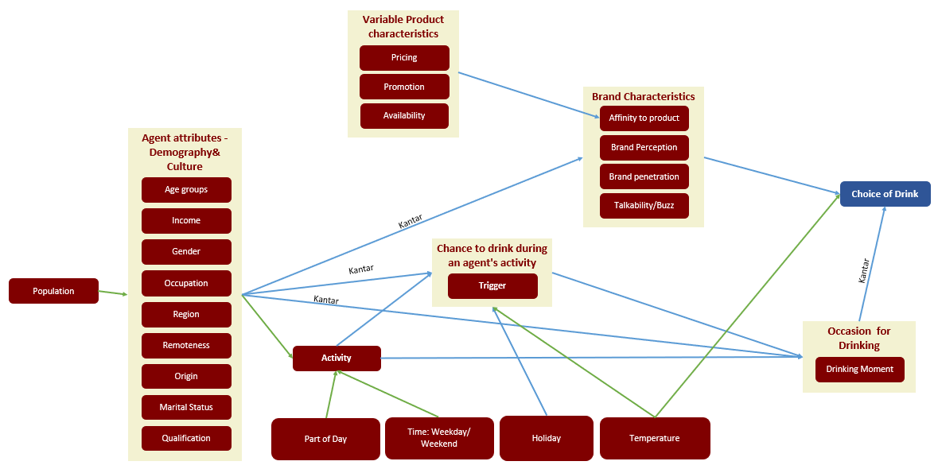
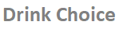
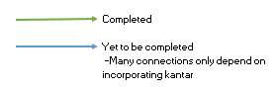
Overview of full network

Slide 16
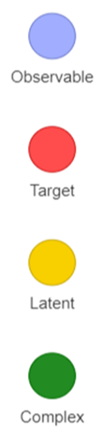
Definition of terms in Bayesian network
Example
Data extracted directly from the data
Temperature data
Data that the model is trying to generate
Which brand the customer chooses
Data that is generated from the analysis of observable data
Whether the customer chooses to drink
A group of observable data that is repeatedly used in calculating latent and target data
Demographic Data from Kantar

Slide 17
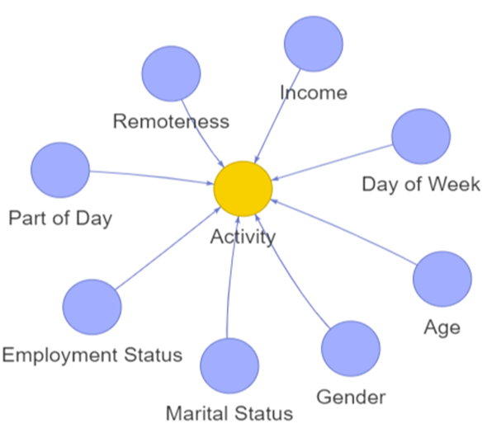
What if population growth continues at ~2% PA driven by cap cities with a 50/50 mix of organic to immigration?
Three controls are provided to the user:
Population growth rate
Immigrant growth rate
Urban growth rate
In the course of simulation, the population grows annually taking into account the ethnicity and urbanicity components
The following steps are executed sequentially:
1.
Relation between activities and demographics is obtained through market research
The model predicts the activity for that part of the day and day of the week for the given demographic

Slide 18
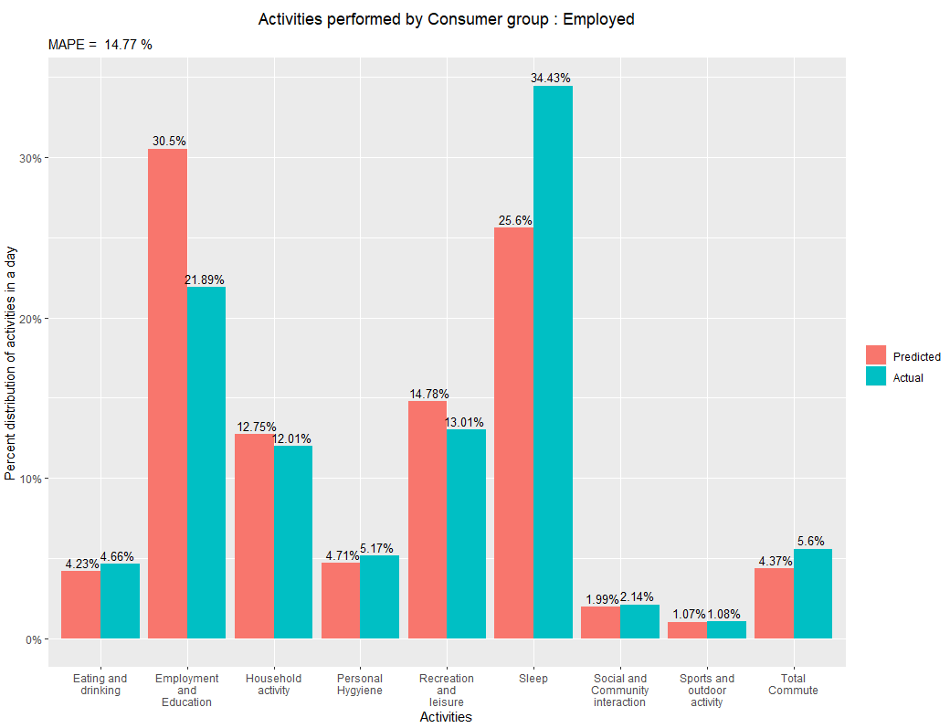
Model progress: Activity Insights
This model underestimates sleep and overestimates employment and education which amount to 55% of the day
The average employed Australian spends only 2% of his day in social and community interaction
The average employed Australian is spending 5% of the day eating and drinking which the model was accurate in predicting

Slide 19
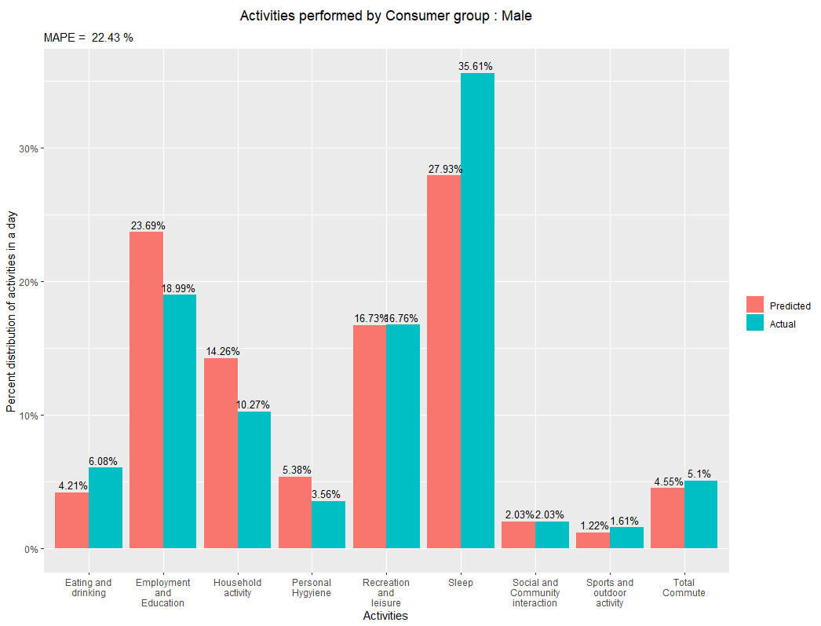
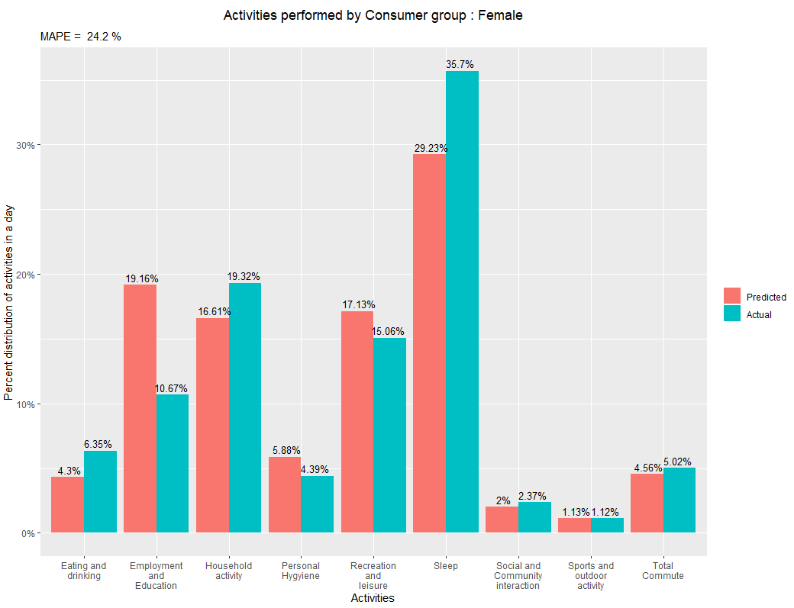
DEEP dive into gender difference in activities
Drinking occasions are generated during ‘Recreation and Leisure’ and ‘Social and Community Interaction’ and ‘Eating and Drinking’ activities. These activities are being predicted precisely in our model according to Australia census

Slide 20
DEEP dive into gender difference in activities
Household – Females spend 9% more in of their day in household activities than males
Questions – Is spending more time in household activities an increase or a decrease to the likelihood of drinking? Is this gap between the genders consistent across demographics like age or religion?
Work – Males spend 8% more in of their day in employment and education than females
Question – Is spending more time in employment and education an increase or a decrease to the likelihood of drinking?

Slide 21
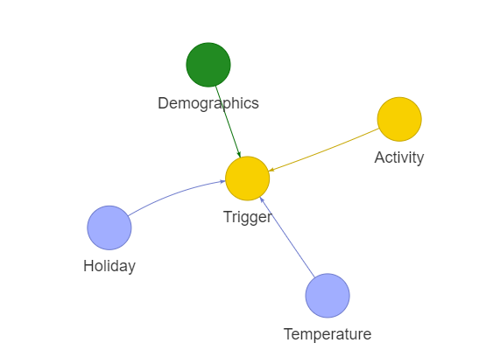
What if population growth continues at ~2% PA driven by cap cities with a 50/50 mix of organic to immigration?
2.
The model will then predict whether the agent will drink
Insights from temperature to frequency of drinking will be incorporated in the model
Next Steps: Once the relationship between frequency of drinking to demographics & activity is extracted from Kantar, this section of the model should be completed shortly

Slide 22
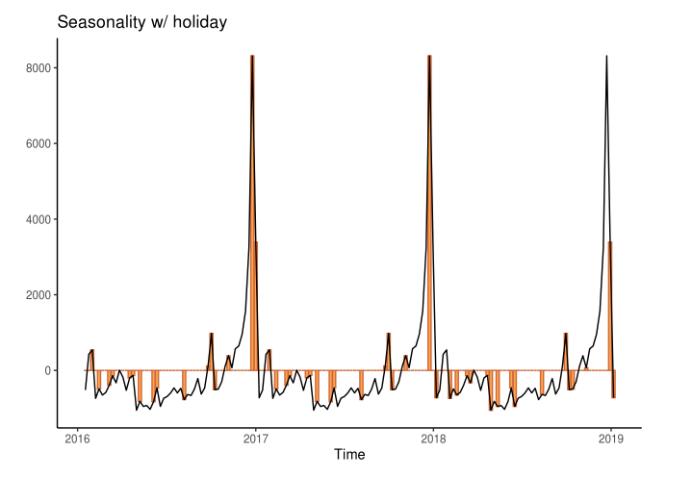
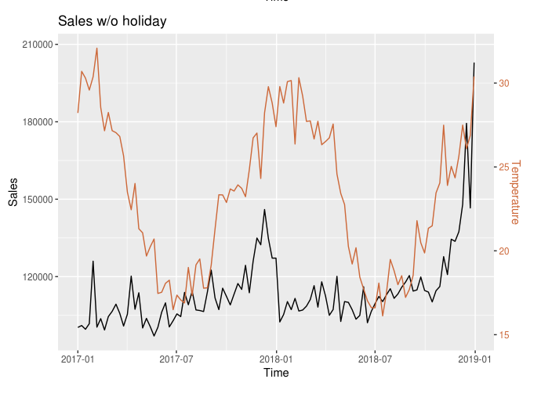
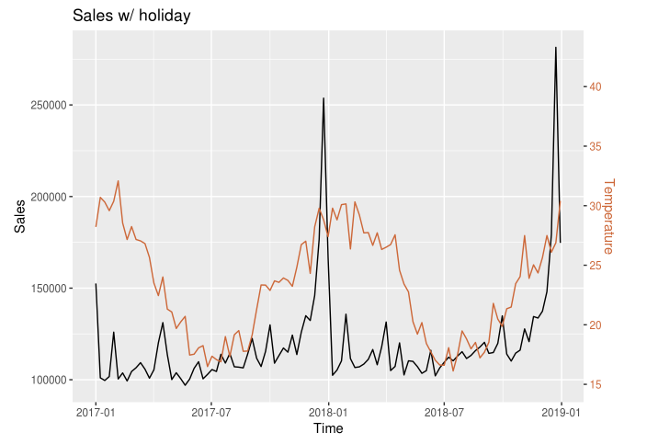
Effects of temperature and holidays on sales
1.Sales due to seasonality over time and Holidays
2.Effect of Temperature on Sales
Seasonal sales
Sales w/o holiday
Holiday
Temperature
Sales
Sales
Seasonality in sales is highly inline with Holidays both during crest and troughs(plot 1)
Normalizing the effect of holidays, there is a linear relationship between Temperature and Sales(plot 2)
Hence, both effect of Temperature and Holiday together is considered to predict Trigger
3.Effect of Temperature and Holiday on Sales
Sales
Temperature
Sales

Slide 23
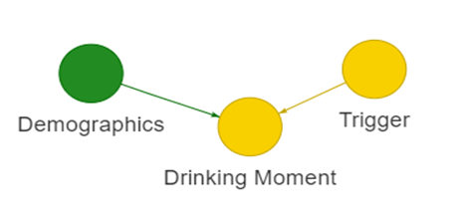
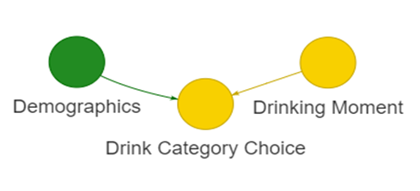
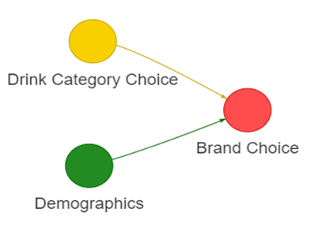
What if population growth continues at ~2% PA driven by cap cities with a 50/50 mix of organic to immigration?
3.
Extracting the relation between demographics, drinking moment and drink choice from Kantar surveys to obtain
why the agent is drinking
which category of drink the agent has chosen
what brand the agent has chosen
Next Steps: Simulate data with default growth rates to validate the model accuracy and fine tune performance. Then simulate for required rates and derive insights to answer the question
4.
5.

Slide 24
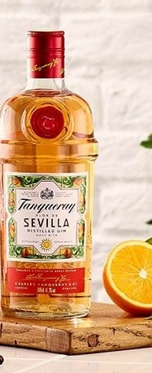
What’s Next
Incorporating insights from Kantar into the model for the following
Drinking occasion based on demographics
Brand choice based on occasion
Brand talkability/buzz
Brand penetration
Brand perception
ETA: Aug 16th
Running a model simulation incorporating the above and validating the drink choice model with actual sales
ETA: Aug 21nd
Iterating on the model to fine tune performance
ETA: Aug 26th
Simulate for multiple scenarios and derive insights for the questions
ETA: Aug 31st
Mu-Sigma team is following up with Sprinklr and AUS Business team for additional data, hence still requires assistance from Diageo

Slide 25

Appendices
March 12, 2019
Prepared by Karen Chisholm and Adam Ben-Yousef

Slide 26
Agent based modelling
Diageo has identified Agent Based Modelling (ABM) as a promising approach to the challenge of understanding the underlying drivers of major shifts in the drinks market.
Agent Based Modelling differs from conventional analytical and modelling techniques used in marketing in a number of important respects. It complements existing techniques, and helps marketers to answer different, but relevant, questions:
ABM focuses on the behavioral and environmental drivers of the patterns that we see in aggregate data, so we have a chance to understand the causes of trends, not just to spot them.
It looks at the total market, not just focusing on one brand or company, and so is able to capture the effects of changes in one brand or subcategory on another.
It looks at the effects of things that are not under the marketer’s control, such as changes in population demographics or policy impacts, as well as those that are.
It is an individual-based technique, and as such is able to capture the differences in response amongst consumers across the market: not only in terms of differences driven by demographic characteristics, but also differences in preference and behavior.
It can capture differences or changes in behavior amongst different geographically located portions of the population.
ABM is a simulation based (what if …)
Page 26

Slide 27
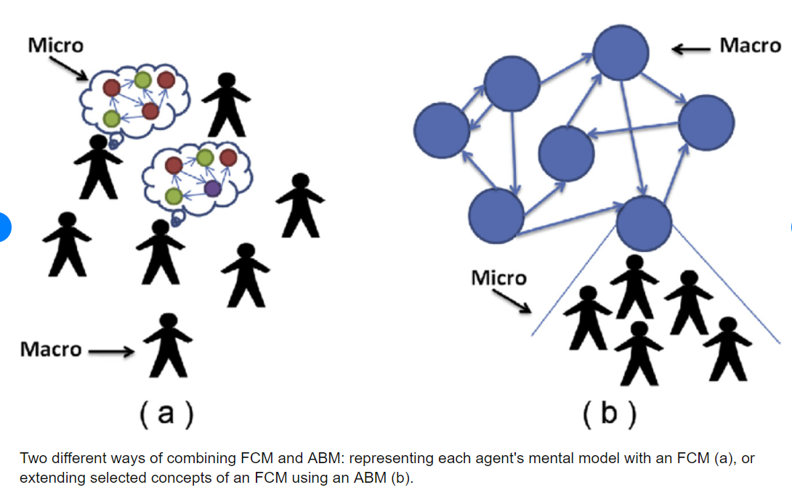
Agent based modelling: Micro and MACRO
Micro
Macro
Individual consumer behaviors
Behavior choices
Brand equity / saliency
Size of population
Population demographics – count by cohort (age/ income, M/F, etc)
Category volumes
Page 27

Slide 28
Causal Model & Simulation
Deliverable | Proof of Concept: Construct consumer-level agent causal model and validate simulation against macro-level indicators for the US market
Design Model
Conduct a data audit and secure data. Confirm business questions
Build Model
Run simulations and conduct macro/micro validation
Test Model
Package final deliverable answering the question “Were we able to simulate consumer behavior accurately and identify causal effects in the consumer decision-making mechanism?”
Estimate the initial causal models based on available data sources
Define heuristic priors from existing market research as well as expert opinions
Update causal models
2 iterations and review
Share experiment results
Page 28

Slide 29
Model UX infrastructure scenario Planning
Scenario | Description | View | Cost | Timeline
1. Bonus-feature-planned- beyond scope | Build the interphase is R Shiny | No long possible b/c R Shiny is not compatible with Diageo’s Azure environment | N/A | N/A
2. Original Scope | Lacks interface Will provide charts Will provide presentations ( using R Notebooks) | Possible | No additional costs | Original timeline; end of August
3. Power BI (scope change) | Will build out interface using Power BI tool set | Possible w/ high cost implications | £45K GBP | End of September
4. Creative approach using Power BI | Harshini to explore options further | Change to team structure | TBC | Extend timeline by an additional 6-8 weeks
5. Pause project and build the Power BI Platform, supported by DBS | Brian and team want a Power BI solution –let’s DBS fund | High Risk Out of scope | TBC | Extend timeline by an additional 6-8 weeks
Page 29

Slide 30
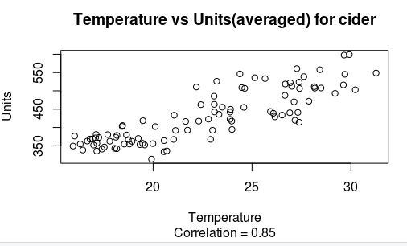
Effects of temperature on individual categories
Once the sales of the categories were
examined for their correlation to the
temperature, cider was revealed to
have a correlation with temperature

Slide 31
PROJECT WORKFLOW
Data Consolidation
Network Design
Understand Consumer Behaviour
Simulation Tool
Productize
Data Type | Source | Availability
Customer Demographics | Census, Experian
Drinking Behavior | Kantar surveys
Purchase Behavior | Kantar Surveys
Holidays / Occasions | Macroeconomic
Sales and transactions | Depletions
Product Characteristics | AU Scan
Pricing and Promotions | Diageo
Color Key
 | Available
 | Unavailable
PHASE COMPLETE

Slide 32
PROJECT WORKFLOW
Data Consolidation
Network Design
Understand Consumer Behaviour
Simulation Tool
Productize
PHASE IN-PROGRESS

Slide 33
PROJECT WORKFLOW
Data Consolidation
Network Design
Understand Consumer Behaviour
Simulation Tool
Productize
ILLUSTRATIVE
PHASE IN-PROGRESS

Slide 34
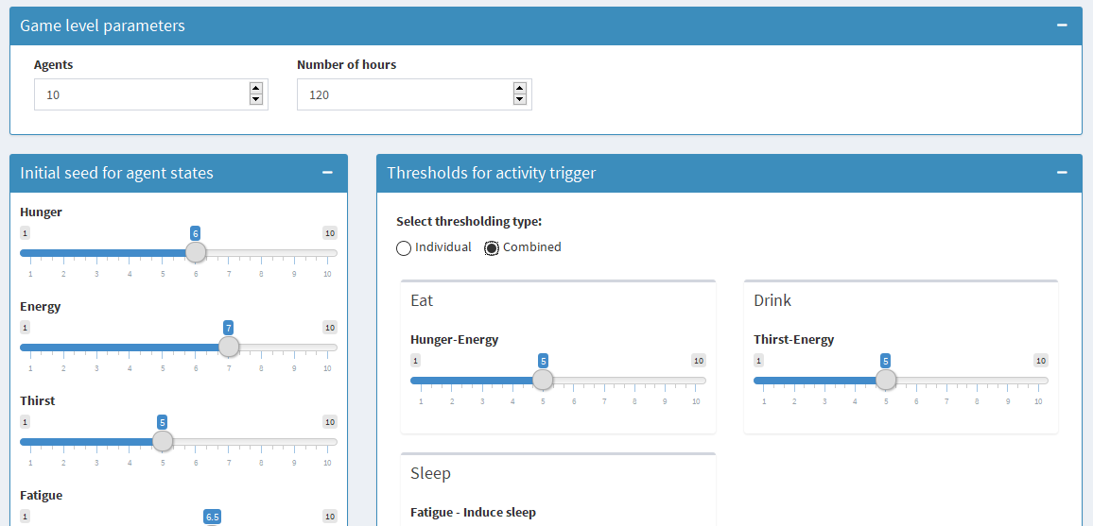
PROJECT WORKFLOW
Data Consolidation
Network Design
Understand Consumer Behaviour
Simulation Tool
Productize
ILLUSTRATIVE
ON HOLD

Slide 35
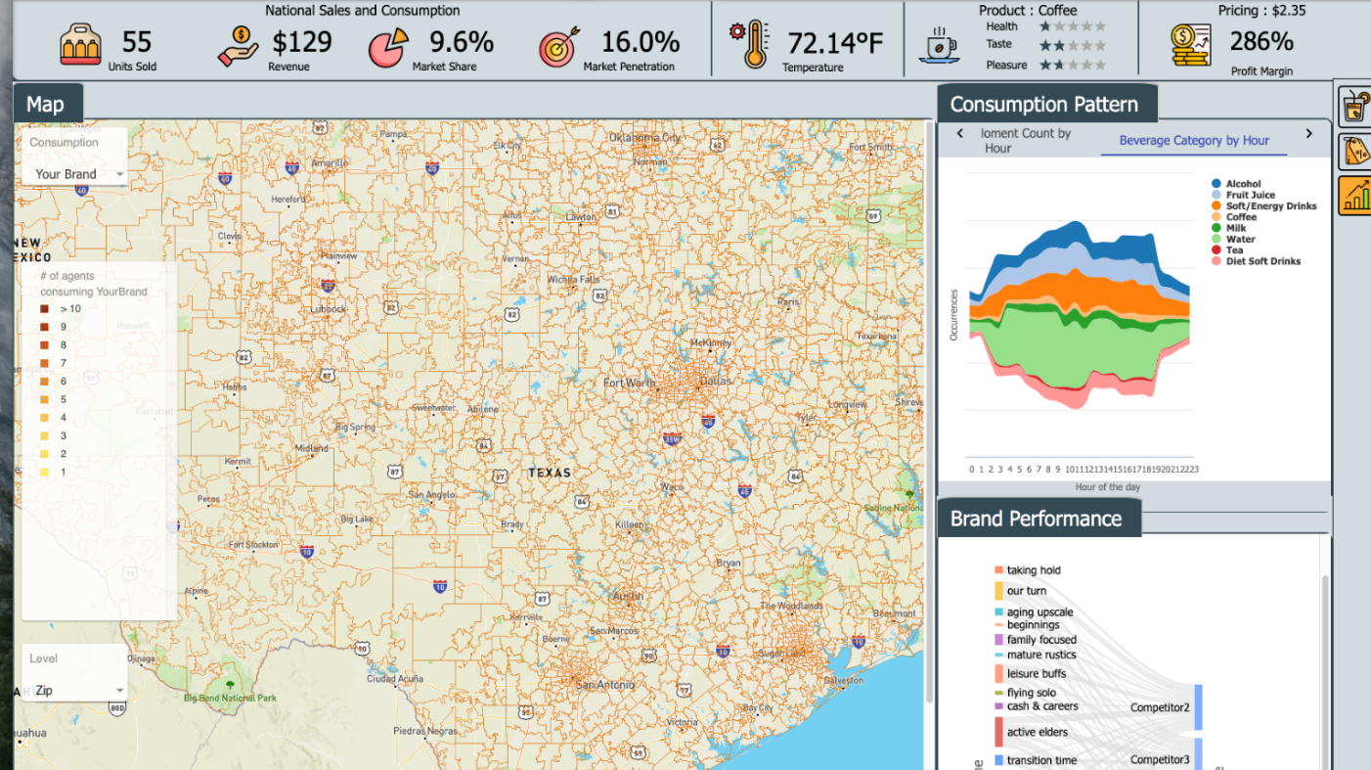
PROJECT WORKFLOW
Data Consolidation
Network Design
Understand Consumer Behaviour
Simulation Tool
Productize
ILLUSTRATIVE
ON HOLD

